Slide 1
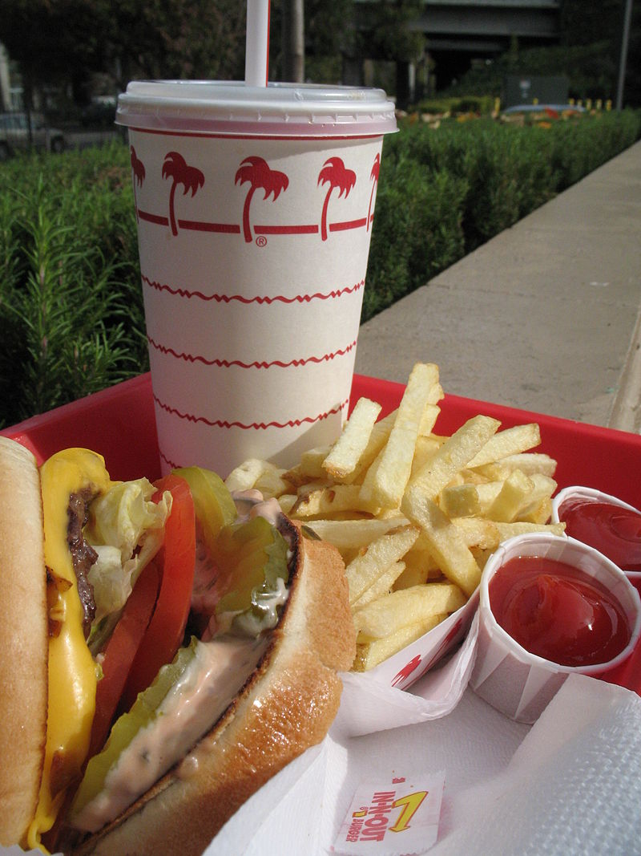


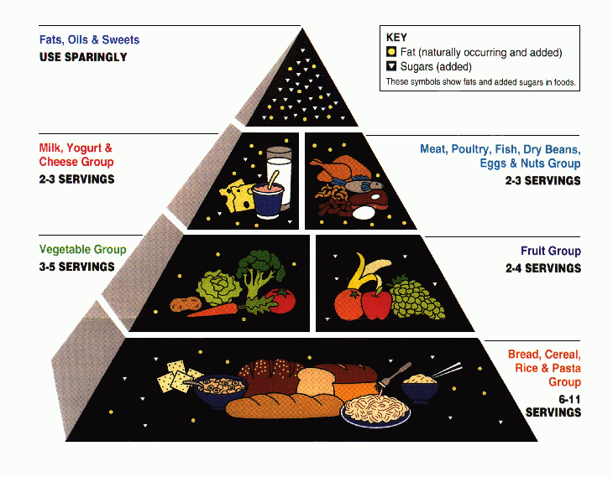
$
Burger cost + … = Total Cost
Objective: Save money!
Subject to: Nutritional concerns
Hamburger,
fries,
etc
Objective: minimize cost
Subject to: (Nutritional concerns):
Cost function
Variables:
OPTIMIZATION

Slide 2
Objective Function
g(x) ≤0, h(x) = 0
LINEAR
No
Yes
Integer
Variables
Yes
Integer Variable
Si
No
No
Integer
Linear
Programming
Non Linear Programming
Linear
Programming
Mixed Integer
Non Linear
Programming
SIMPLEX
Branch
& Bound
SQP,
GRG
Outer Aproximation

Slide 3
Objective Function
g(x)≤0, h(x) = 0
LINEAR
No
Yes
Integer Variables
Integer Variable
Yes
Yes
No
No
Linear
Programming
Mixed–discrete
Programming
Non Linear
Programming
Mixed Integer
Non Linear
Programming
SIMPLEX
Branch & Bound
SQP
Outer
Approximation

Slide 4





Slide 6











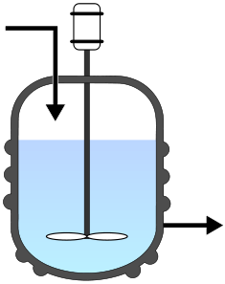
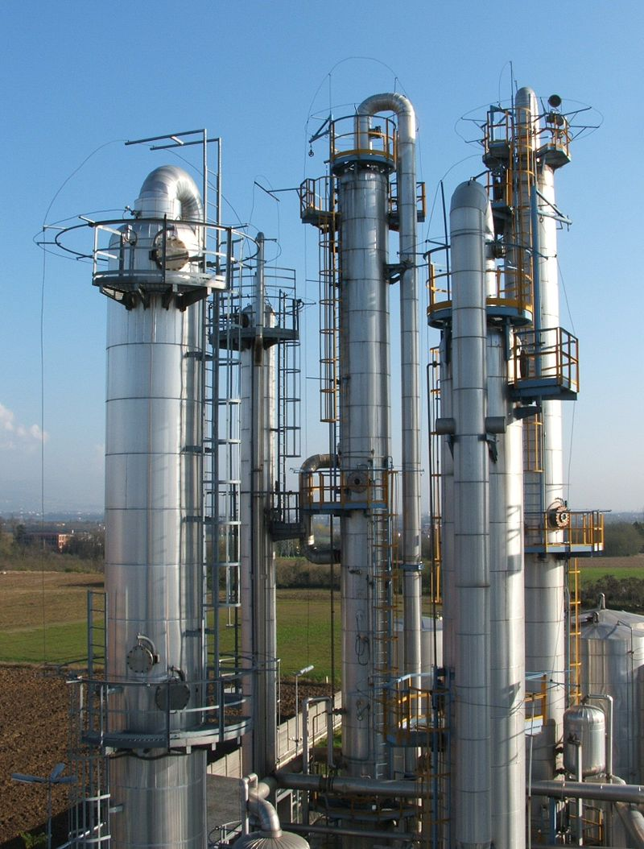
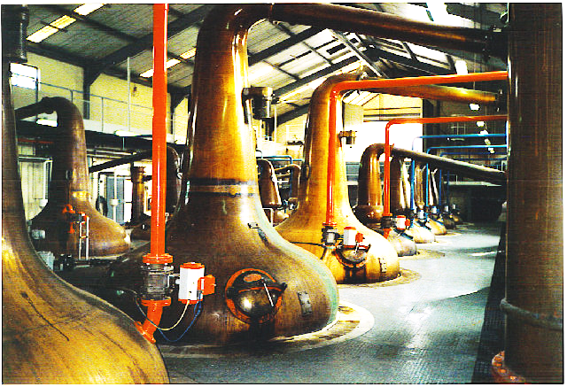
Chemical engineering in a nutshell:
.org
water
+
malt
+
Water waste
(don’t drink this)
hops
yeast
beer
Whisky
(Chemical) reactor
Distillation
or
or
batch
(alembic)
batch
continuous
continuous
(distillation column)

Slide 7
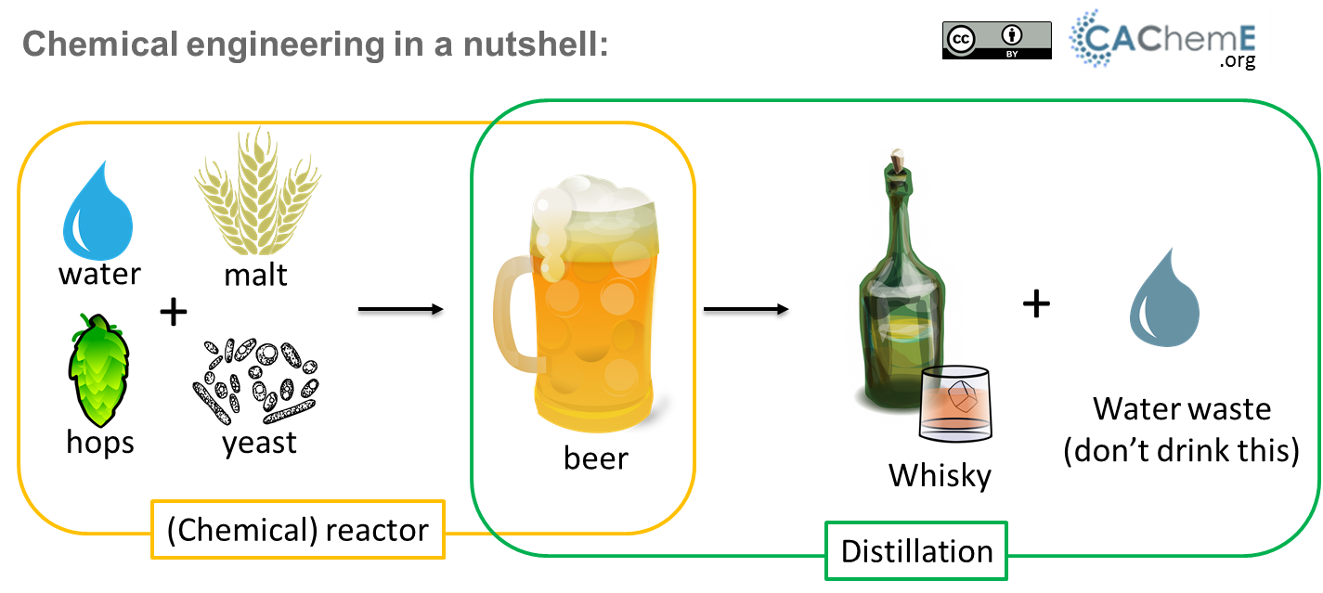

Slide 8
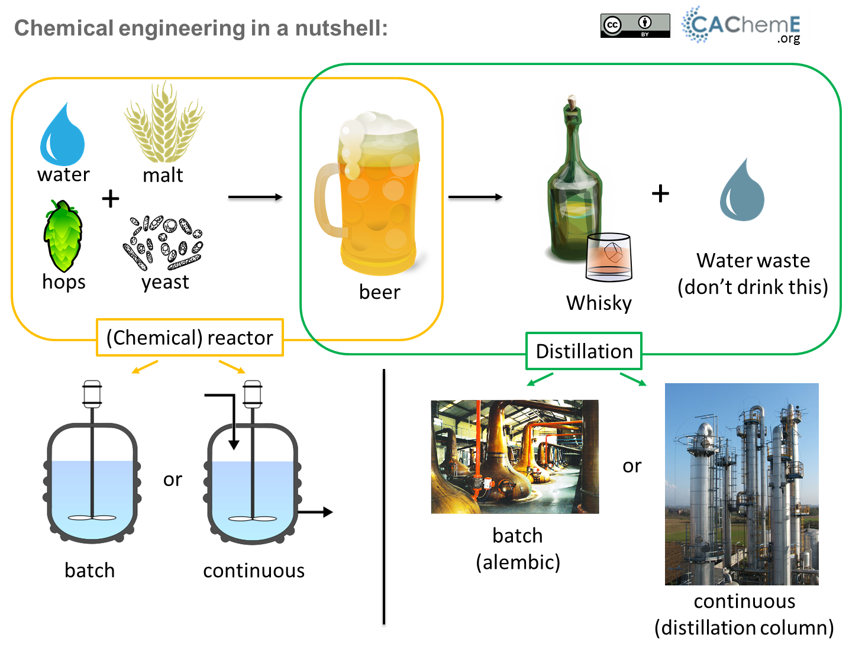

Slide 9
